Slide 1
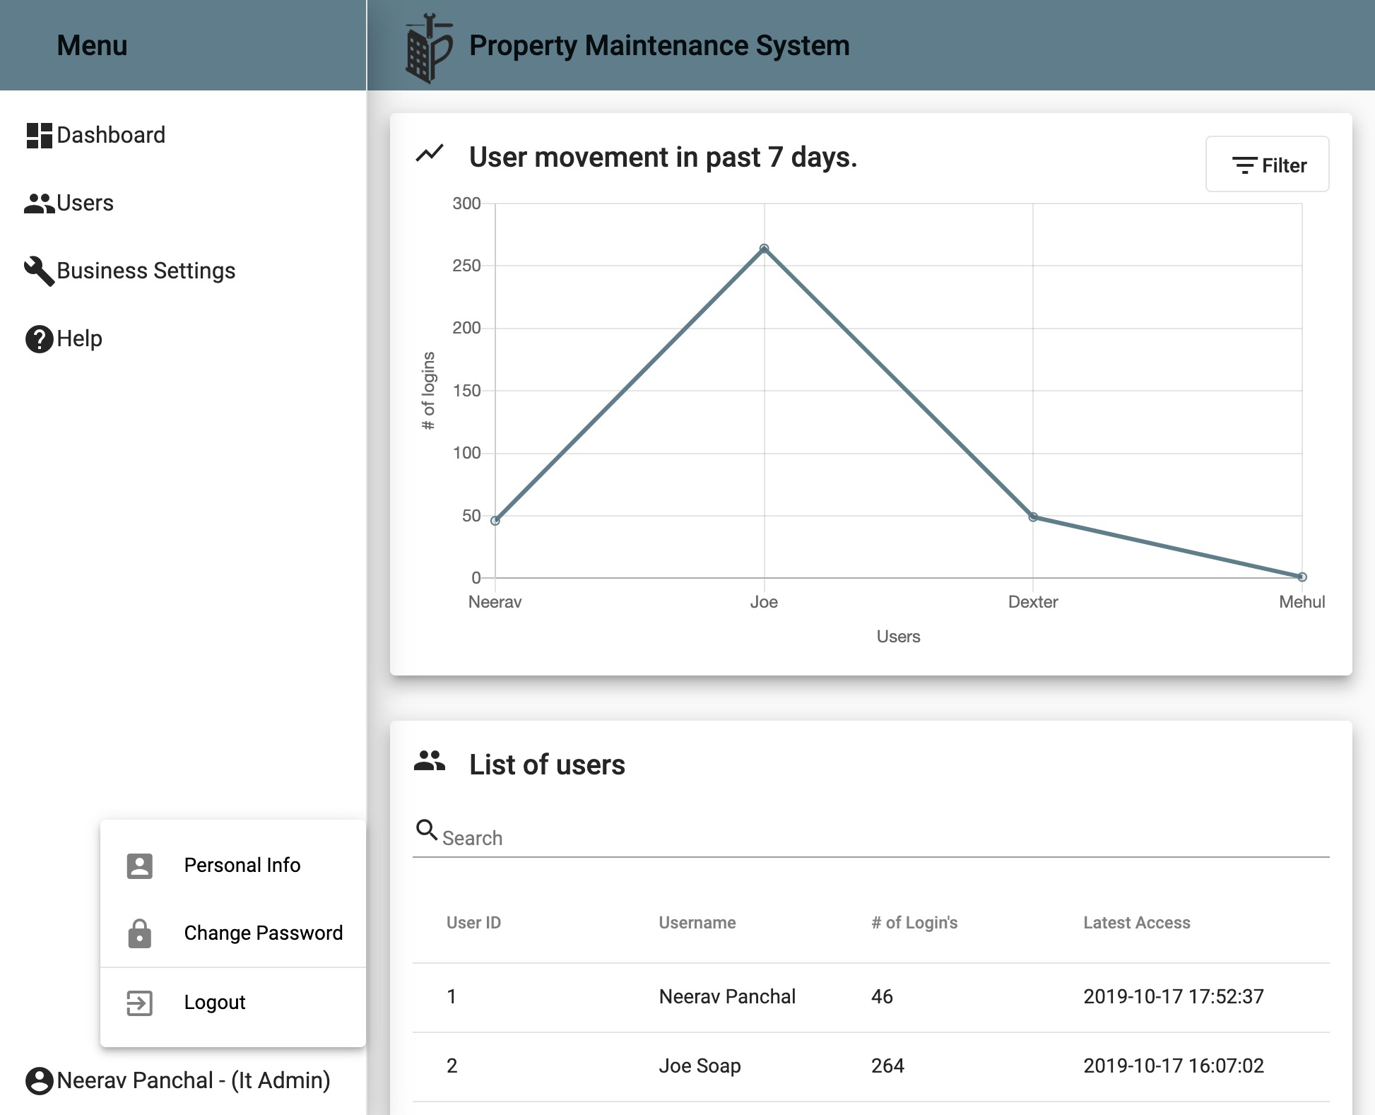
Press ‘Filter’ to filter users movement by the last 7, 14 or 30 days.
Click here to get redirected to a page that will allow you to change your personal details.
Click and type in this field to search.
Click here to get redirected to a page that will allow you to reset your password.

